Slide 1
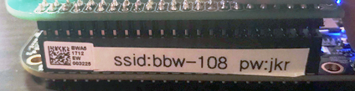
Pre-Workshop Setup
Download these three files:
https://bit.ly/2TySY5P - python-syntax.py
https://bit.ly/2tbzIQt - presentation.pdf
https://bit.ly/2GeRJG9 - smbus-doc.pdf
Power On Beaglebone Black Wireless
Connect USB cable to board
Connect other end of USB cable to PC
Connect to Beaglebone Black Wireless access point
Wait ~4 minutes after your board has been powered on
Connect to board’s wifi access point
Wifi ssid is what you see on the board’s label after ssid:
Wifi password is beaglebone_ and then you add the 3 characters after pw:
The above image means the ssid is bbw-108 and the password is beaglebone_jkr

Slide 2



Super Introduction to Embedded Linux Workshop
Franklin Cooper
University Marketing Manager
2

Slide 3
Quick Questionnaire
Who has used Python before?
Who has used a microcontroller before like Raspberry PI or Beaglebone?
What is Linux?
Remember Download these three files:
https://bit.ly/2TySY5P https://bit.ly/2tbzIQt https://bit.ly/2GeRJG9

Slide 4

Goals
Expose you to one of the most popular programming languages
Expose you to real world problems
Make you sweat
Have fun
Did you downloaded these three files?
https://bit.ly/2TySY5P https://bit.ly/2tbzIQt
https://bit.ly/2GeRJG9

Slide 5
Not Familiar with Python?
Look at python-syntax.py ← you downloaded this
Ask a neighbor
Google (on your phone)
I hope you downloaded these three files
https://bit.ly/2TySY5P https://bit.ly/2tbzIQt
https://bit.ly/2GeRJG9

Slide 6
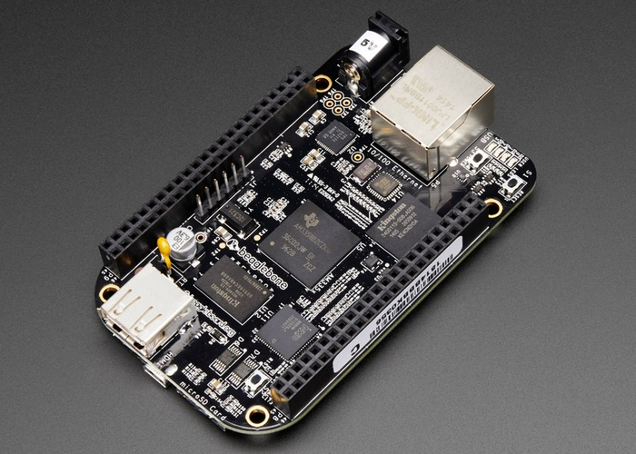
Beaglebone Black Wireless Quick Summary
Open Source Community Board
Based on TI Technology
Like the Raspberry Pi but better when interfacing with hardware
Integrated Wifi
Intergrated Bluetooth
6

Slide 7


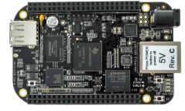
Everything Is Running Off The Beaglebone
Router
Web Page
Python
IDE (Cloud 9)

Slide 8
Lets Get Started

Slide 9
Trouble Shooting
Make sure your board is plugged in to your computer via USB and is turned on
Board powered on = Blinking blue leds on top right of board
Make sure your connected to the board via wifi
Sometimes the connection drops and will reconnect to another wifi access point
3. Make sure the URL your using starts with http://192.168.7.2
Always include http:// and don’t use https://
4. When using Cloud9 manually hit save File->Save or CTRL+S before running
If you updated your program and the output hasn’t changed. Then this is your cdddadproblem

Slide 10

Play Beaglebone Based Bop It
Goal :
Play Bop It using Push Button, Potentiometer and Light Sensor

Slide 11
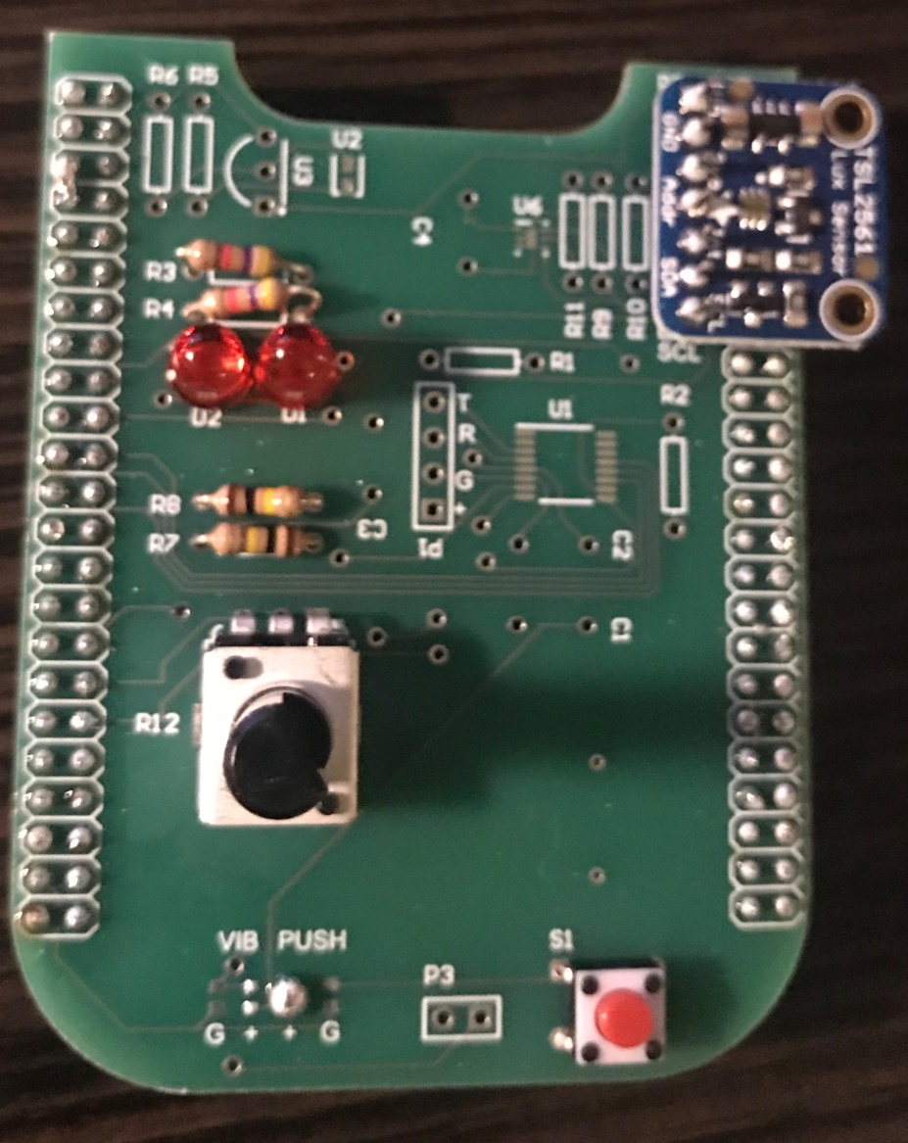
Beaglebone Workshop Cape
BLOCK IT!
Light Sensor
Connected to:
P9_19
P9_20
TWIST IT!
Potentiometer
Connected to:
P9_36
PUSH IT!
Push Button
Connected to:
P9_29
11

Slide 12
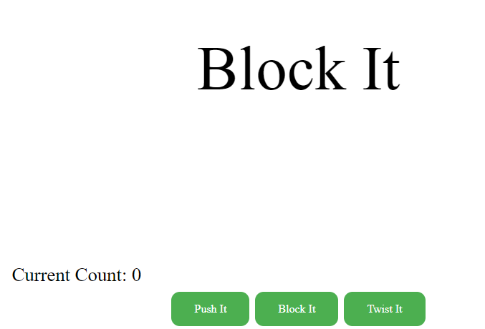
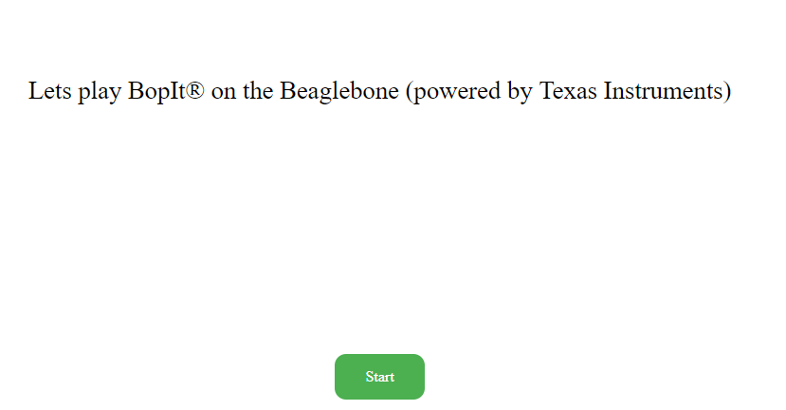
Task 1 – Play TI Beaglebone BopIt
Goto: http://192.168.7.2:8080/workshop/bopit/
Turn down your computer’s speaker (IMPORTANT)
Hit Start
You will see and/or hear a command
Hit the correct button below that corresponds with the command
12

Slide 13
Cloud 9 – Quick Summary
Browser Base IDE
Supported Languages:
Python
C
C++
and much more
Supports Debugging
13

Slide 14
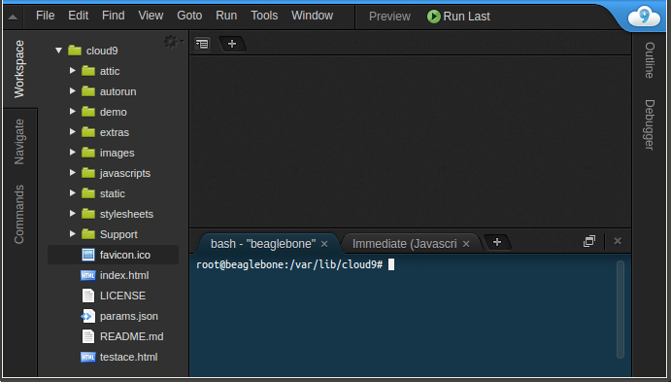
Task 2 – Connect to Cloud 9 IDE
Open up a web browser (don’t use IE)
Go to http://192.168.7.2:3000/ (May take 2-3 minutes for page to load)
You should see something like the below
* Type the above link as is. So you must include http:// and do not use https://
14

Slide 15
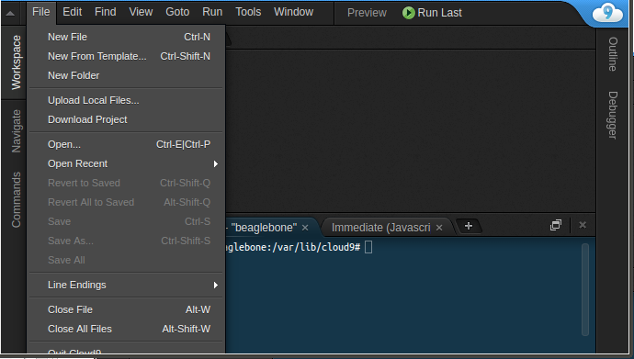
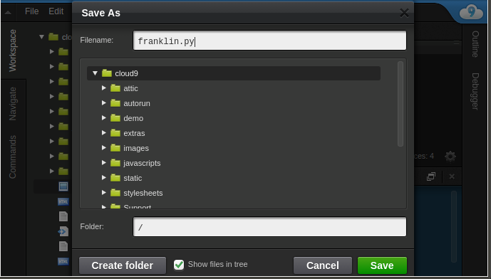
Cloud 9 – How to Create a New File
Create New File
Goto File->New File
Now Save File
Goto File->Save
Give file a name
MUST end with .py for Python programs
Hit green Save button
Shortcut to Save File
CTRL+S
15

Slide 16
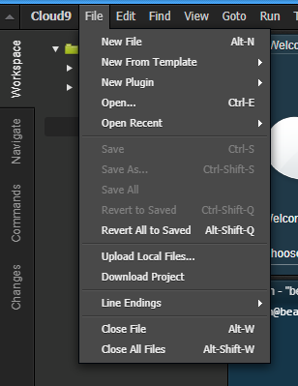
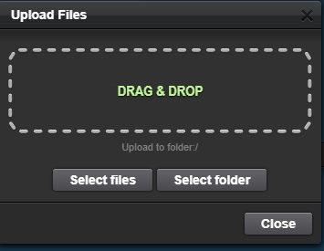
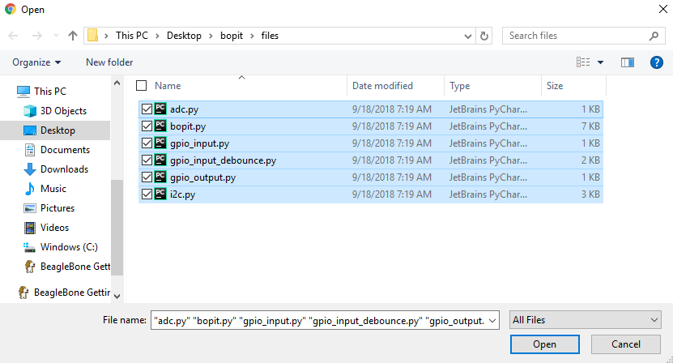
Cloud 9 – How to Import a File on Your PC
Upload Local File(s)
Goto File->Upload Local Files
Hit “Select files’
Navigate to the files you want to upload
Highlight all the files you want to upload
Hit Open
16

Slide 17
Task 2 – Import Workshop Files
Upload Local File(s)
Goto File->Upload Local Files
Hit “Select files’
Navigate to where you extracted bopit.zip
Go into the files directory
Highlight all Python files (ends in .py)
Hit Open
17

Slide 18
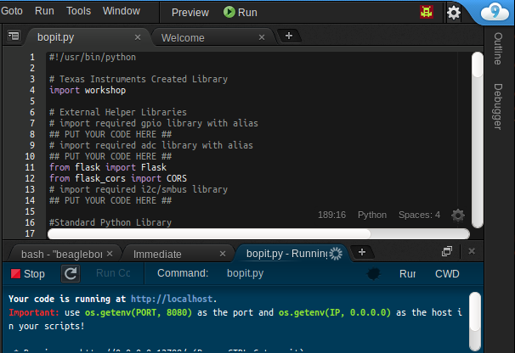
Cloud 9 – Running Program
Make sure the Python file you want to run is currently displayed.
Hit Run Button to “run your program”
* Important Tip*
Before running save your file first.
18

Slide 19
Task 3 – Run Bopit_board_test.py Program
Run the bopit_board_test.py program.
This will help verify your board is in working order.
Look at the console and follow the commands.
If you get any failures then alert your instructor.
*When twisting make sure you
turn it by a significant amount
19

Slide 20
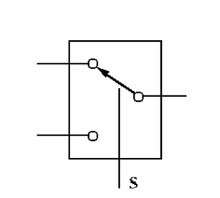
Hardware – Pinmux
Pinmuxing is when a signal can be connected via a mux (switch) to various other signals
gpio
P9_29
i2c_sda
Internal
(Inside Chip)
External
(What you can access)
Pinmuxing is used on almost every signal pin on the Beaglebone

Slide 21
Software – Pinmux
To simplify configure a pin’s pinmuxing you can use a program/script called config-pin
debian@beaglebone:~$ config-pin P9_29 gpio
debian@beaglebone:~$ config-pin -q P9_14
P9_14 Mode: pwm
debian@beaglebone:~$ config-pin -l P9_14
default gpio gpio_pu gpio_pd pwm
Set P9_29 to gpio
Python version (What you will be using)
workshop.setPinMux("P9_29","gpio")
Set P9_29 to gpio mode.
Modes you will use in this workshop:
gpio and i2c
Get information regarding
P9_14 current setting
Output ->
Get list of modes you can
Set P9_14 to
Output ->

Slide 22
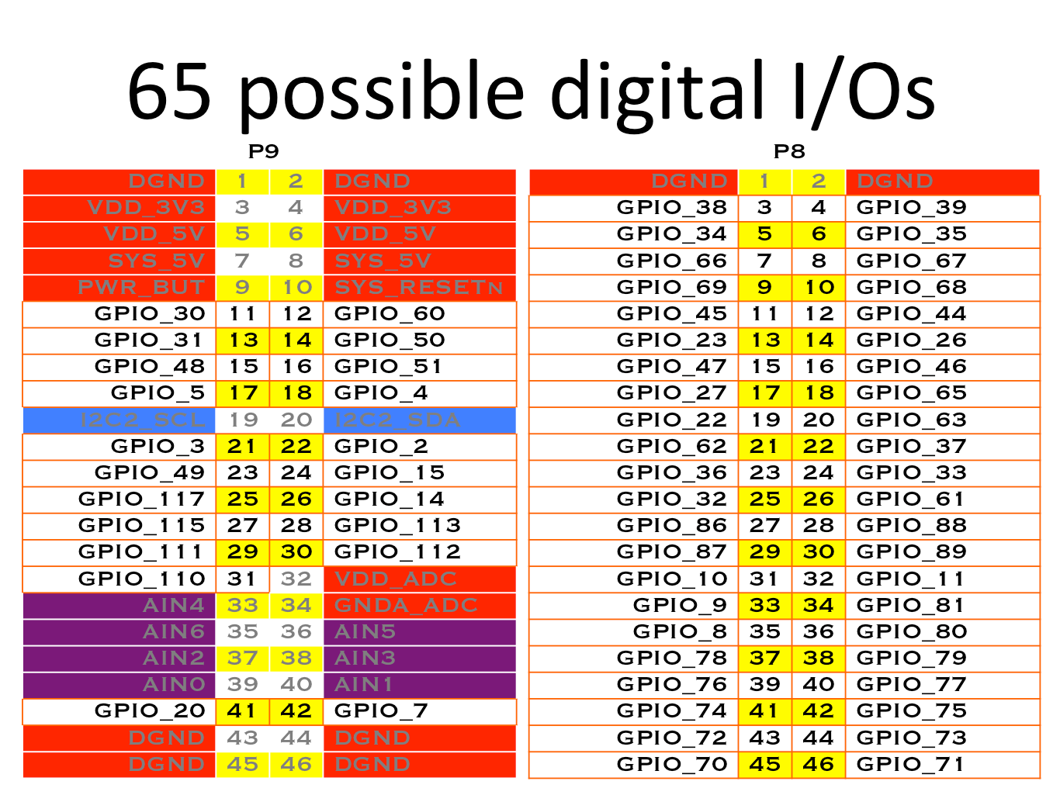
Peripheral – GPIO: Basic Electrical Information
Input -
High (1) : voltage >= 2 V
Low (0) : voltage <= .8 V
Output
High (1) : 3.3 V
Low (0) : 0 V
22

Slide 23
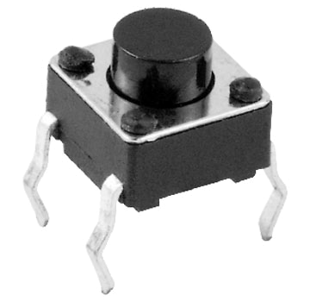
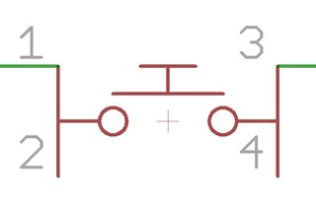
Hardware - Push Button: Introduction
Basic Switch – by default pins 1 and 2 are not connected to pins 3 and 4.
23

Slide 24
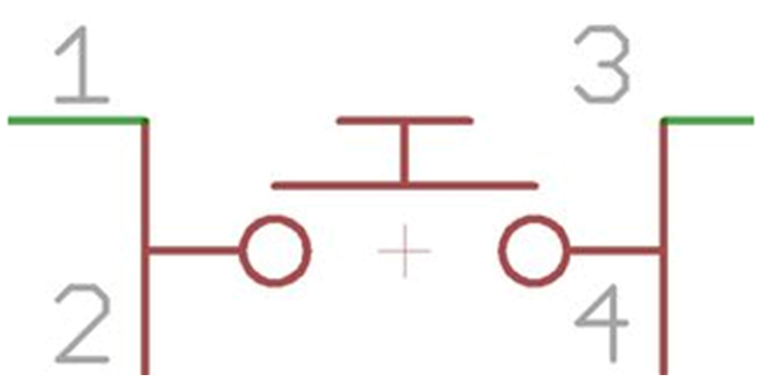
Hardware – Push Button: Wiring
BBB Header Pin P9_29 is connected to one side of tactile switch. VCC is connected to other side of tactile switch.
P9_29
+3.3V
24

Slide 25
Quiz 1 - GPIO
What is the value of a input pin when nothing is driving it (outputting a voltage to it)?
25

Slide 26

Hardware – Pullup and Pull Down Resistors
Typical Usage:
Provide a steady/default value
BBB Pin Configuration:
Supports internal pullup and internal pulldown
Adafruit library allows you to configure internal pull up and pull down
P9_29
+3.3V
26

Slide 27
Adafruit Library – Quick Introduction
Adafruit created a peripheral library for BBB:
Python Based
Simple to Use
Lose some flexibility
27

Slide 28
Adafruit Library – GPIO (Input)
Including/Import
import Adafruit_BBIO.GPIO as GPIO
What does this mean?
28

Slide 29
Adafruit Library – GPIO (Input)
Including/Import
import Adafruit_BBIO.GPIO as GPIO
Library alias (reduce the amount of typing you do)
29

Slide 30
Adafruit Library – GPIO (Input)
Including/Import
import Adafruit_BBIO.GPIO as GPIO
Configuration:
GPIO.setup(“<PIN_NAME>”, GPIO.IN)
Configures GPIO as an input (pull up resistor by default)
GPIO.setup(“<PIN_NAME>”, GPIO.IN, pull_up_down=GPIO.PUD_DOWN)
Configures GPIO as an input (pull down by default)
Usage:
GPIO.input(“<PIN_NAME>”)
Returns 1/True if voltage is high and returns 0/False if voltage is low
30

Slide 31
Adafruit Library – GPIO (Output)
Including/Import
import Adafruit_BBIO.GPIO as GPIO
Configuration:
GPIO.setup(“<PIN_NAME>”, GPIO.OUT)
Configure pin as an output
Usage:
GPIO.output(“<PIN_NAME>”, GPIO.HIGH)
Set pin to high
GPIO.output(“<PIN_NAME>”, GPIO.LOW)
Set pin to low
31

Slide 32
Task 4 – Basic GPIO Program
Goal: print a message every time you push the button
Open gpio_input.py file that you previously loaded into Cloud 9.
Replace all the lines that says ## PUT YOUR CODE HERE ## with your code
Read the comment to understand what your being asked to do for the lines your writing code for
Use the information I provided in the previous slides to do this
Run the program and tap the button quickly to see if you achieve your goal
Remember:
Try:
Tap push button once as fast as possible and see what your program outputs
P9_29
+3.3V
Configure internally
32

Slide 33
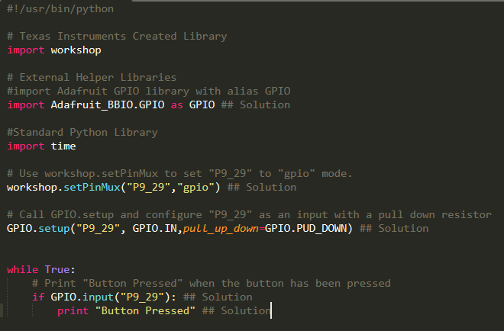
Task 5 – Basic GPIO Program (Solution)
33

Slide 34
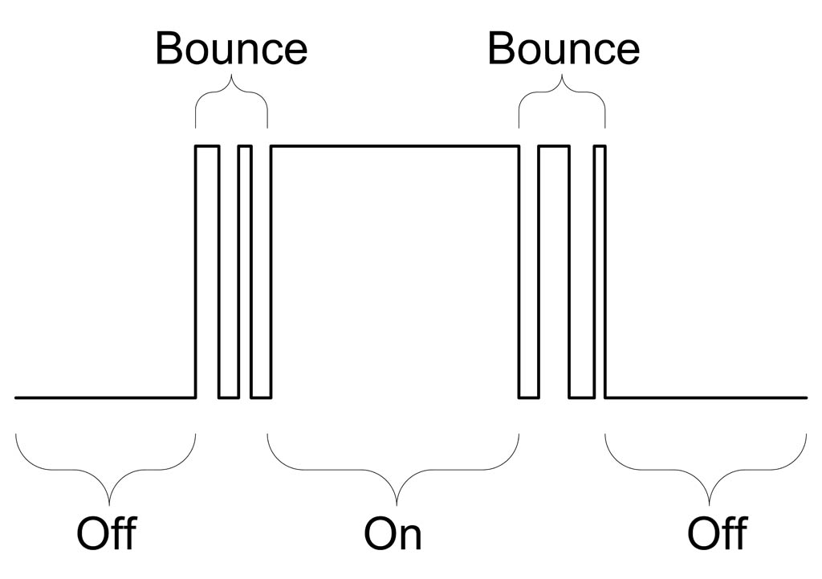
Hardware - Issue
Switch Bouncing:
Occurs when pushing or release buttons/switch
How do you solve it?
34

Slide 35
Hardware – Debounce Solution
Simple software solution:
When state change ignore any future state changes for X ms
Detect button release
Don’t read for X ms
Don’t read for X ms
Detect button press
35

Slide 36
Task 6 – Debounce GPIO Program
Goal: print a message ONCE (ie debounce) every time you push the button
Open gpio_input_debounce.py file that you previously loaded into Cloud 9.
Replace all the lines that says ## PUT YOUR CODE HERE ## with your code
Read the comment to understand what your being asked to do for the lines your writing code for
Use the information I provided in the previous slides to do this
Run the program and tap the button quickly to see if you achieve your goal
Remember:
Try:
Feel free to change the debounce timeout value to see how it impacts the program
P9_29
+3.3V
Configure internally
36

Slide 37
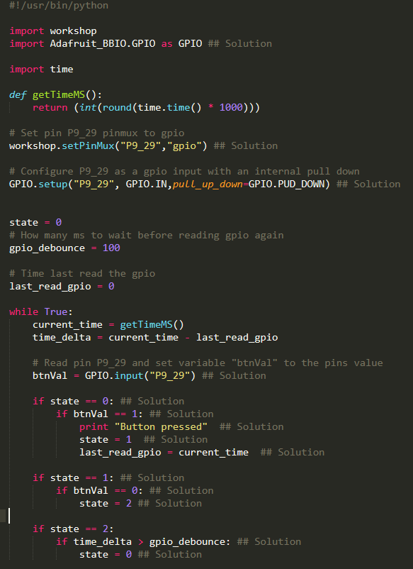
Task 6 – Debounce GPIO Program Solution

Slide 38
Task 7 – Update Bopit to use Push Button
If bopit.py is running make sure you stop it.
Replace all the lines that says “## PUT YOUR CODE HERE ##” within the functions “gpioSetup()” and getPushButtonVal()”.
Run bopit.py program
Go to http://192.168.7.2:8080/workshop/bopit/
What to expect:
Push It – Push the push button on the green board
Twist It – Click the button with the mouse on web page
Block It – Click the button with the mouse on web page
38

Slide 39

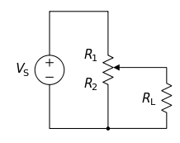
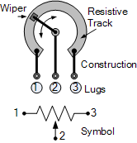
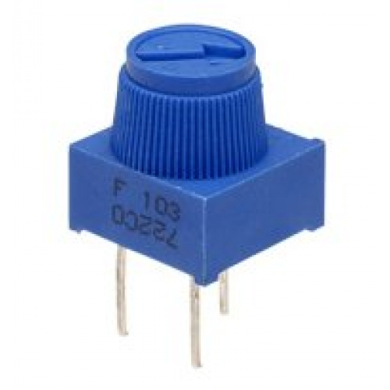
Hardware: Potentiometer
What is it:
Variable Resistor
Increase/decrease resistance via knob
Can be used as a voltage divider
Middle pin is output of divider
39

Slide 40
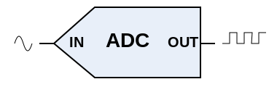
Peripheral – Analog to Digital Converter (ADC)
Purpose
Converts analog voltage to digital value
Useful for sensors that output voltage only
Beaglebone Black's ADC is a 12 bit ADC:
Digital Value Range
0 – 4095
Max support input voltage:
1.8 V
40

Slide 41
Adafruit Library – ADC
Including/Import
import Adafruit_BBIO.ADC as ADC
Configuration:
ADC.setup()
Usage:
ADC.read(“<PIN_NAME>”)
Returns a decimal value from 0.0 – 1.0
ADC.read_raw(“<PIN_NAME>”)
Returns a digital value from 0 - 4095
41

Slide 42
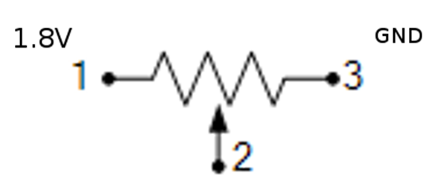
Task 8 – Read Potentiometer
Goal: Print the voltage being read by the potentiometer
Open adc.py file that you previously loaded into Cloud 9.
Replace all the lines that says ## PUT YOUR CODE HERE ## with your code
Read the comment to understand what your being asked to do for the lines your writing code for
Use the information I provided in the previous slides to do this
Run the program and tap the button quickly to see if you achieve your goal
Remember:
P9_36

Slide 43
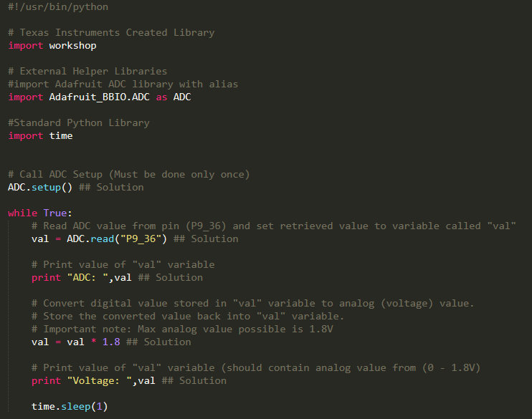
Task 8 – Read Potentiometer Solution
43

Slide 44
Task 9 – Update Bopit to use Potentiometer
If bopit.py is running make sure you stop it.
Replace all the lines that says “## PUT YOUR CODE HERE ##” within “adcSetup()” and “readPotentiometerVal()” function.
Go to http://192.168.7.2:8080/workshop/bopit/
What to expect:
Push It – Push the push button on the green board
Twist It – Turn (a lot) the potentiometer on the green board
Block It – Click the button with the mouse on web page
44

Slide 45
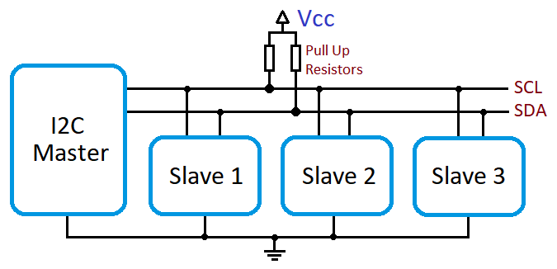
Peripheral – I2C Quick Summary
Quick Summary
Uses 2 Pins
SCL – Clock
SDA – Data
Half Duplex
Speed “Typical” Ranges 1K to 400K
Supports Multiple Nodes
Communicate to specific node via unique address
Multi Master
45

Slide 46
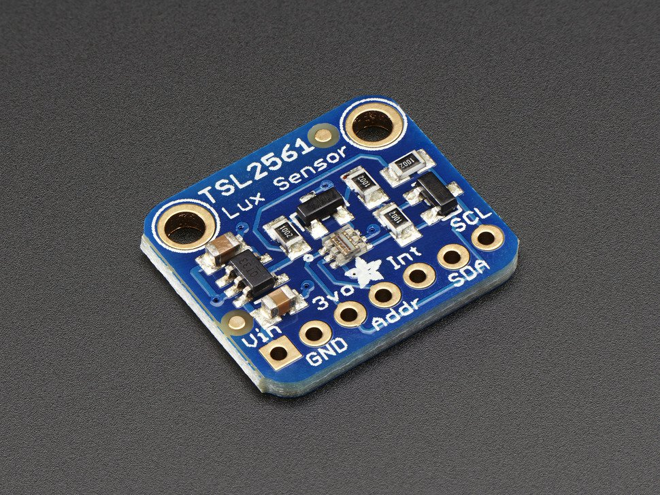
Hardware – Light Intensity Sensor
Summary:
Default address 0x29
Requires Configuration
Has defined sample rate
Returns ambient light
levels
46

Slide 47
Task 10 – I2C Light Intensity
Goal: print light intensity every second
Open i2c.py file that you previously loaded into Cloud 9.
Replace all the lines that says ## PUT YOUR CODE HERE ## with your code
Update the code based on the comments that explain what is expected.
Use the information I provided in the previous slides to do this as well as the smbus pdf included in the bopit.zip you extracted earlier.
Run the program and tap the button quickly to see if you achieve your goal
Remember/Hint:
Device is on bus 2 (not 0 which the pdf uses)
Device address is 0x29
Try:
Feel free to change the debounce timeout value to see how it impacts the program

Slide 48
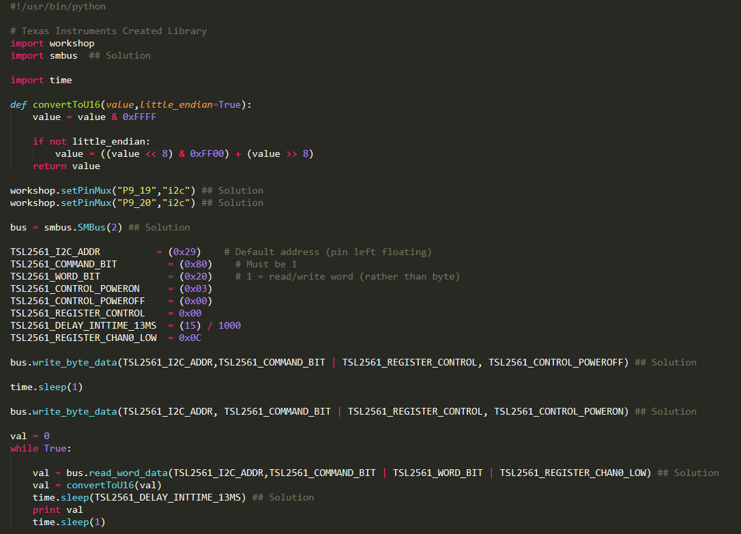
Task 10 – I2C Light Intensity Solution

Slide 49
Task 11 – Update Bopit to use Light Sensor
If bopit.py is running make sure you stop it.
Replace all the lines that says “## PUT YOUR CODE HERE ##” with your code within functions “i2cSetup()” and “getLightValue()”.
Run bopit.py program
Go to http://192.168.7.2:8080/workshop/bopit/
What to expect:
Push It – Push the push button on the green board
Twist It – Turn (a lot) the potentiometer on the green board
Block It – Cover and uncover light sensor on the green board
49

